Slide 1

The Data Extractors
Test Plan
Mason Lanham
Austin Meredith
Luis Carrillo
Chris Mendoza
David Garcia
Notes:
Team slide copied since beginning

Slide 2
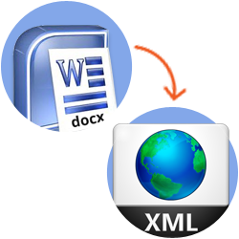
Purpose
The Word Text Data Extractor is a piece of software made in Python that will take Microsoft Word documents, mainly instruction manuals or documents with procedures for the reader to follow, parse them, then output them via an XML schema.
Notes:
Purpose of the program

Slide 3
Features To Be Tested
Base States:
BS-0: No applications running
BS-1: Base Command Line Terminal
BS-2: Command Line Terminal w/ Program Running & Menu Prompt
BS-3: Input File Location/Name Specified & Valid
BS-4: Output Location Specified & Valid
BS-5: Output File Name Specified & Valid
BS-6: Input and Output Filepaths are Specified & Valid
BS-7: Help Menu
Test Cases:
TC-1: Parse and Label Docx Document (UC-1)
TC-2: Set Output File Location (UC-2)
TC-3: Set Output File Name (UC-3)
TC-4: Set Input Filepath (UC-4)
TC-5: Use Help Options (UC-5)
TC-6: Start the Program (UC-6)
TC-7: End the Program (UC-7)
Notes:
Base states the program will sit in at certain points in the user process, Test Cases that will be tested to ensure success

Slide 4
Features Not To Be Tested
Because of the nature of our project, there are no features of the program that are not included in the testing.
Each command will have to be tested, which will involve each method and/or function being tested.

Slide 5
Approach
We will utilize a combination of testing techniques for our program:
On the functional testing side we will, and have been, unit testing as we develop.
We perform Integration Testing when cooperative pieces are complete.
We will be utilizing System Testing once coding is completed.
Lastly, we will include Mr. Tang from Tietronix in a final Acceptance Test, with a possible non-functional Performance Test to ensure it performs to his liking.
Notes:
The approach we’ll take to testing our program and pieces of it

Slide 6
Suspension Criteria & Resumption Requirements
Suspension Criteria | Resumption Requirements
Commands are not working as intended | The command must be fixed immediately due to some commands being dependent on others. Once the team resolves the issue, return to testing
Significant error in the XML output | Team will meet virtually to solve the error to resume testing
Any of the official Test Cases fail | Resolve the failure, ensure all official Cases pass

Slide 7
Environmental Needs
The basic requirements for this program are a modern computer or similar device, that is capable of running Windows 10 with Microsoft Office, as well as python programs.
Notes:
The testing environment requirements are very basic.

Slide 8
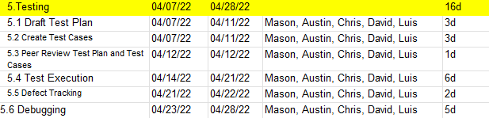
Schedule
Notes:
From the Design document’s schedule.

Slide 9
Acceptance Criteria
Stakeholder sign-off and consensus of satisfaction between all team members.
The program should run without defects, with no environmental error.
Unit Tests should be completed without error, as well as integration and system testing should produce no errors.
Only risk of error could occur from context confusion within the document itself, or disordering of the output XML schema.

Slide 10
Roles & Responsibilities
Mason Lanham - Project Test Lead, Testing Manager, Test Approver, Tester, Debugger, Reviewer.
Austin Meredith - Testing Manager, Test Designer, Test Approver, Tester, Debugger, Reviewer.
Luis Carrillo - Test Approver, Tester, Debugger, Reviewer.
Chris Mendoza - Testing Manager, Test Designer, Test Approver, Tester, Debugger, Reviewer.
David Garcia - Test Approver, Tester, Debugger, Reviewer.
Project Test Lead – This is the person responsible for oversight of testing on the project.
Testing Manager – This is the person accountable for conducting quality assurance testing and executing on the test plan.
Test Designer – This is the person responsible for creating the test scripts, scenarios, test lives, and so on that make up the tests to be performed.
Test Approver – This is the person responsible for reviewing, validating, and approving the test materials created by the Test Designer.
Tester – This is the person responsible for executing the test scripts, and reporting the results.
Debugger - Each developer has the role of debugger, as we fix our code as we work.
Reviewer – This is the person responsible for reviewing reports from the testers and determining what subsequent actions will be taken.
Notes:
You don’t need to cover everything on this slide, maybe just a couple definitions or just the titles, which titles we all have, or you can edit it how you see fit.

Slide 11
Any Questions?
Notes:
Conclusion

